Slide 1
Overview and business goals
Six weeks ago Pens and Printers launched a new line of office stationary.
The company had 3 different sale strategies:
Email: 2 emails, very little effort from team
Calls: 30 minute call for each customer
Email and calls: 1 email and a 10 min call for each customer.
The business goal is to find out which strategy approach is creating the most revenue for this new product line.

Slide 2
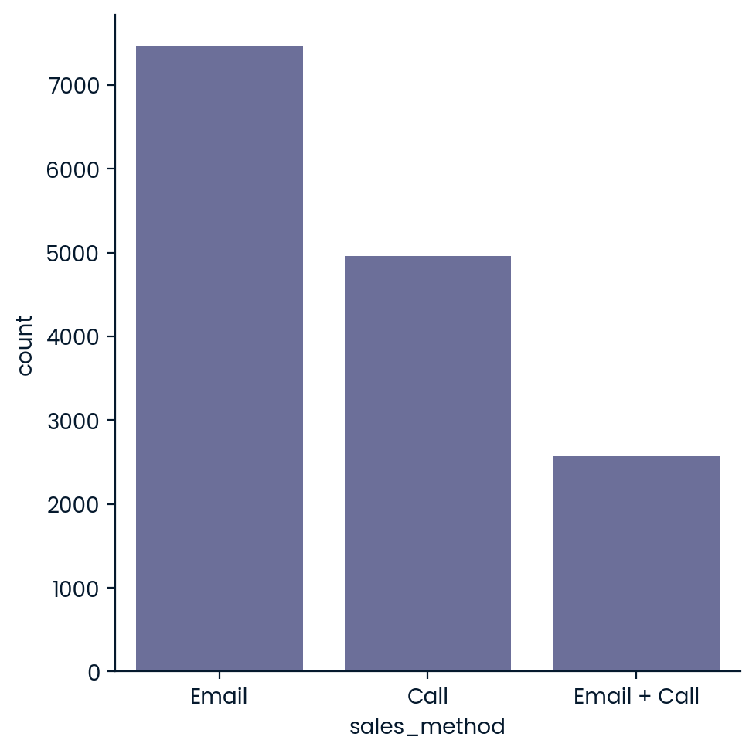
How to address the problem
First, we need to know how many customers we had in each sales strategy group.

Slide 3
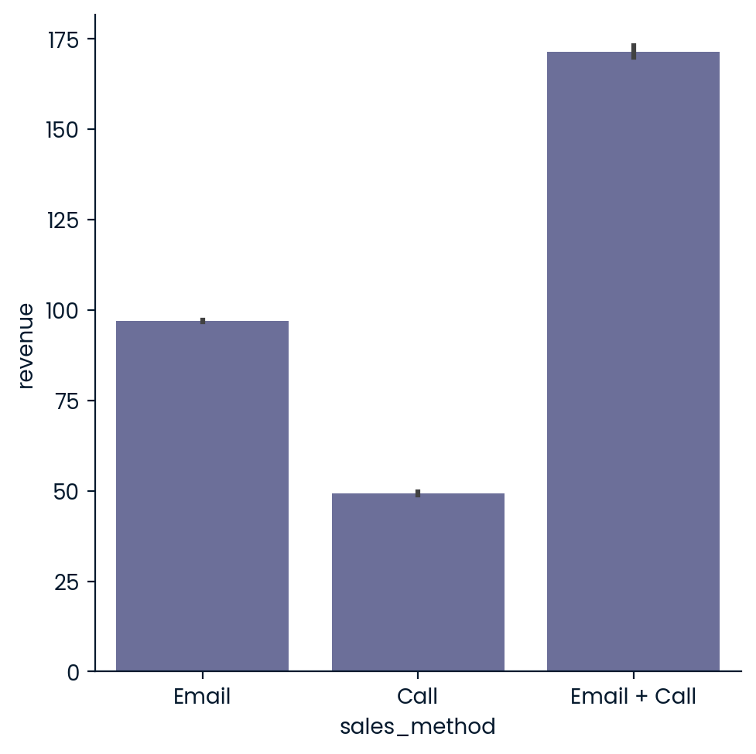
How to address the problem
Next, we need to know how much revenue we achieve with each sales strategy

Slide 4
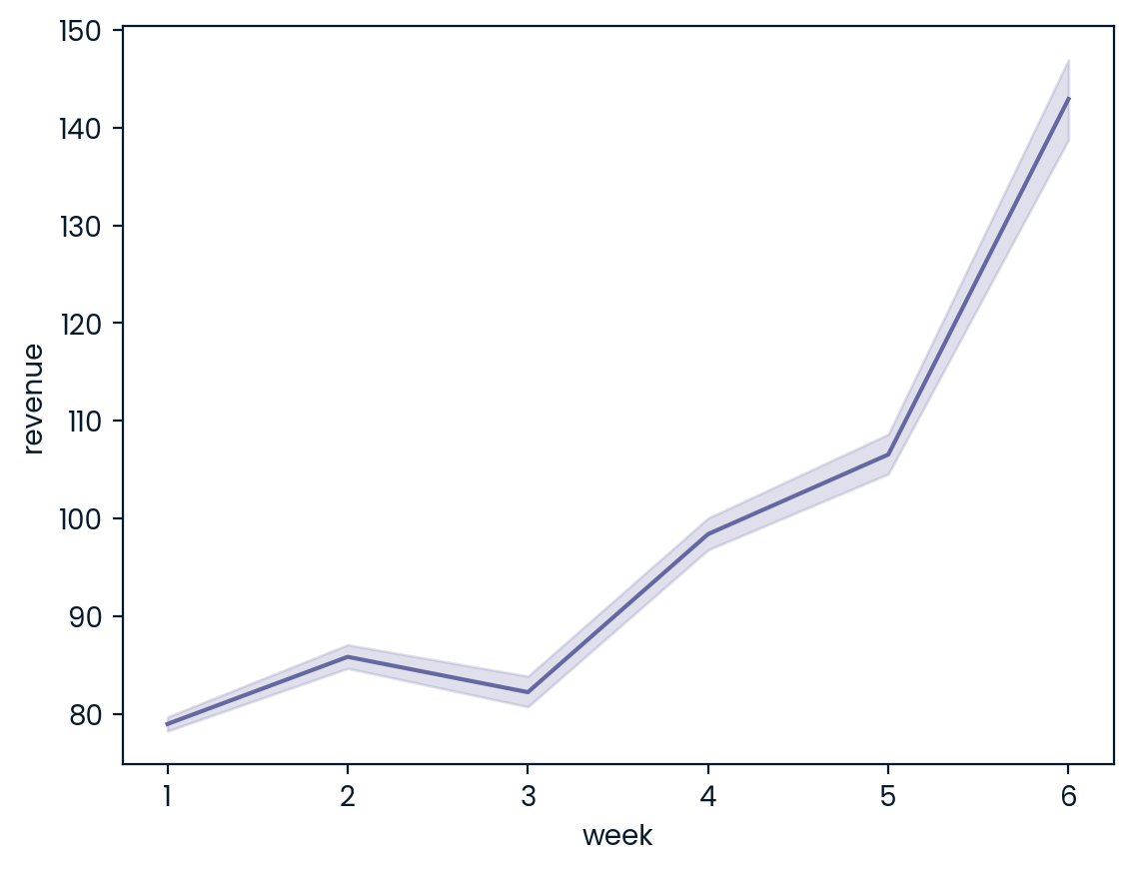
How to address the problem
The key metric to monitor is revenue which we can see increases over time, with an estimated initial value of about 65

Slide 5
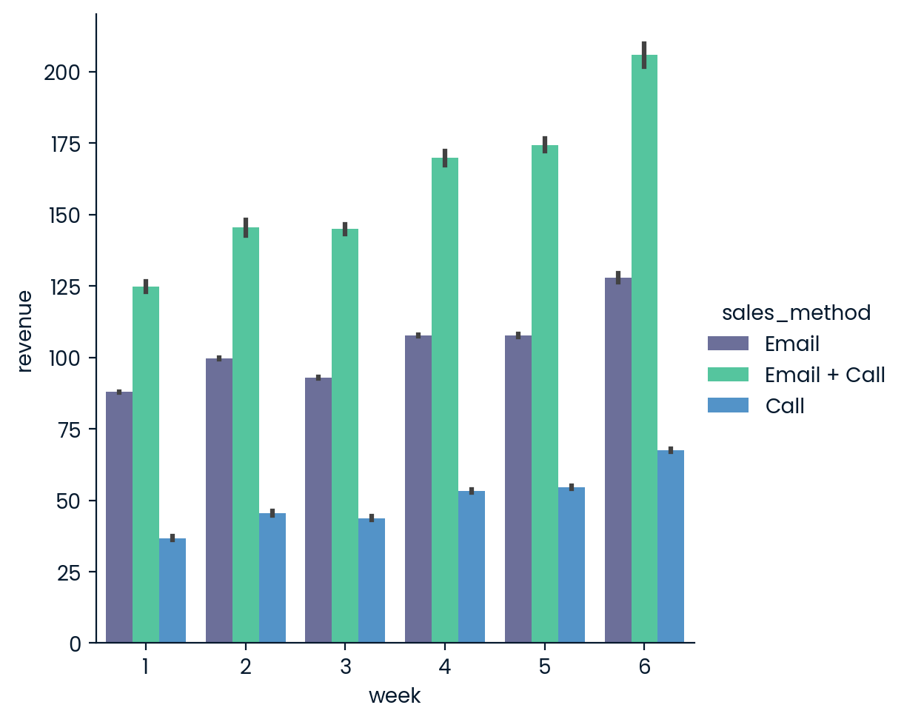
How to address the problem
We can see that the email + call method contributes the most to increasing revenue over all 6 weeks.

Slide 6

Recommendations to the business
I recommend the email + call strategy over the other 2.
The data shows that the Email + Call strategy generates the most revenue, even though it only reached a sixth of the customers.
The reason for this may be the fact that this strategy enabled the sales team to sell more products to each customer.

